Slide 1

ADVENTURE WORK CYCLES
COMMERCIAL AND SALES INSIGHTS

Slide 2
TEAM MEMBERS
MANISHA PRADHAN
VIJAY KAMAT
VARALA PRIYANKA
PODAGATLAPALLI SHANMUKHA VENKATA SAI
SHAIK JAVEED
ANIRUDDHA KIRAN SATALE

Slide 3
TEAM MEMBERS
MANISHA PRADHAN
VIJAY KAMAT
VARALA PRIYANKA
PODAGATLAPALLI SHANMUKHA VENKATA SAI
SHAIK JAVEED
ANIRUDDHA KIRAN SATALE

Slide 4
INTRODUCTION
DOMAIN: Adventure Work Cycles
PROBLEM STATEMENT: Adventure Work Cycles aims to enhance product performance, customer segmentation, and regional profitability through integrated business intelligence tools and SQL-driven analysis.
OBJECTIVE: Deliver actionable insights using Excel, Tableau, Power BI, and SQL to support strategic decision-making.
PROJECT SCOPE: The project covers sales performance, customer demographics, product profitability, and regional market trends to provide comprehensive commercial insights.

Slide 5
INTRODUCTION
DOMAIN: Adventure Work Cycles
PROBLEM STATEMENT: Adventure Work Cycles aims to enhance product performance, customer segmentation, and regional profitability through integrated business intelligence tools and SQL-driven analysis.
OBJECTIVE: Deliver actionable insights using Excel, Tableau, Power BI, and SQL to support strategic decision-making.
PROJECT SCOPE: The project covers sales performance, customer demographics, product profitability, and regional market trends to provide comprehensive commercial insights.

Slide 6
INTRODUCTION
DOMAIN: Adventure Work Cycles
PROBLEM STATEMENT: Adventure Work Cycles aims to enhance product performance, customer segmentation, and regional profitability through integrated business intelligence tools and SQL-driven analysis.
OBJECTIVE: Deliver actionable insights using Excel, Tableau, Power BI, and SQL to support strategic decision-making.
PROJECT SCOPE: The project covers sales performance, customer demographics, product profitability, and regional market trends to provide comprehensive commercial insights.

Slide 7
INTRODUCTION
DOMAIN: Adventure Work Cycles
PROBLEM STATEMENT: Adventure Work Cycles aims to enhance product performance, customer segmentation, and regional profitability through integrated business intelligence tools and SQL-driven analysis.
OBJECTIVE: Deliver actionable insights using Excel, Tableau, Power BI, and SQL to support strategic decision-making.
PROJECT SCOPE: The project covers sales performance, customer demographics, product profitability, and regional market trends to provide comprehensive commercial insights.

Slide 8
INTRODUCTION
DOMAIN: Adventure Work Cycles
PROBLEM STATEMENT: Adventure Work Cycles aims to enhance product performance, customer segmentation, and regional profitability through integrated business intelligence tools and SQL-driven analysis.
OBJECTIVE: Deliver actionable insights using Excel, Tableau, Power BI, and SQL to support strategic decision-making.
PROJECT SCOPE: The project covers sales performance, customer demographics, product profitability, and regional market trends to provide comprehensive commercial insights.

Slide 9
KPI’S AND INSIGHTS
KEY PERFORMANCE INDICATORS:
Total Sales:- $29.4M
Total Profit:- $12.1M
Production Cost:- $17.3M
Tax Amount:- $2.3M
Products Purchased per Order:- 2
INSIGHTS:
Top-selling model:- Mountain-200 ($7.9M)
Top-selling Product Category:- Bikes ($8M)
Gender wise sales:- Male ($14.5M), Female ($14.8M)
Highest profit margin:- United States (35.81%)
Peak sales month:- December ($3.2M)
High Revenue Generated by Year and Day :- 2013($16.4M) - Tuesday($4M)

Slide 10
KPI’S AND INSIGHTS
KEY PERFORMANCE INDICATORS:
Total Sales:- $29.4M
Total Profit:- $12.1M
Production Cost:- $17.3M
Tax Amount:- $2.3M
Products Purchased per Order:- 2
INSIGHTS:
Top-selling model:- Mountain-200 ($7.9M)
Top-selling Product Category:- Bikes ($8M)
Gender wise sales:- Male ($14.5M), Female ($14.8M)
Highest profit margin:- United States (35.81%)
Peak sales month:- December ($3.2M)
High Revenue Generated by Year and Day :- 2013($16.4M) - Tuesday($4M)

Slide 11
KPI’S AND INSIGHTS
KEY PERFORMANCE INDICATORS:
Total Sales:- $29.4M
Total Profit:- $12.1M
Production Cost:- $17.3M
Tax Amount:- $2.3M
Products Purchased per Order:- 2
INSIGHTS:
Top-selling model:- Mountain-200 ($7.9M)
Top-selling Product Category:- Bikes ($8M)
Gender wise sales:- Male ($14.5M), Female ($14.8M)
Highest profit margin:- United States (35.81%)
Peak sales month:- December ($3.2M)
High Revenue Generated by Year and Day :- 2013($16.4M) - Tuesday($4M)

Slide 12
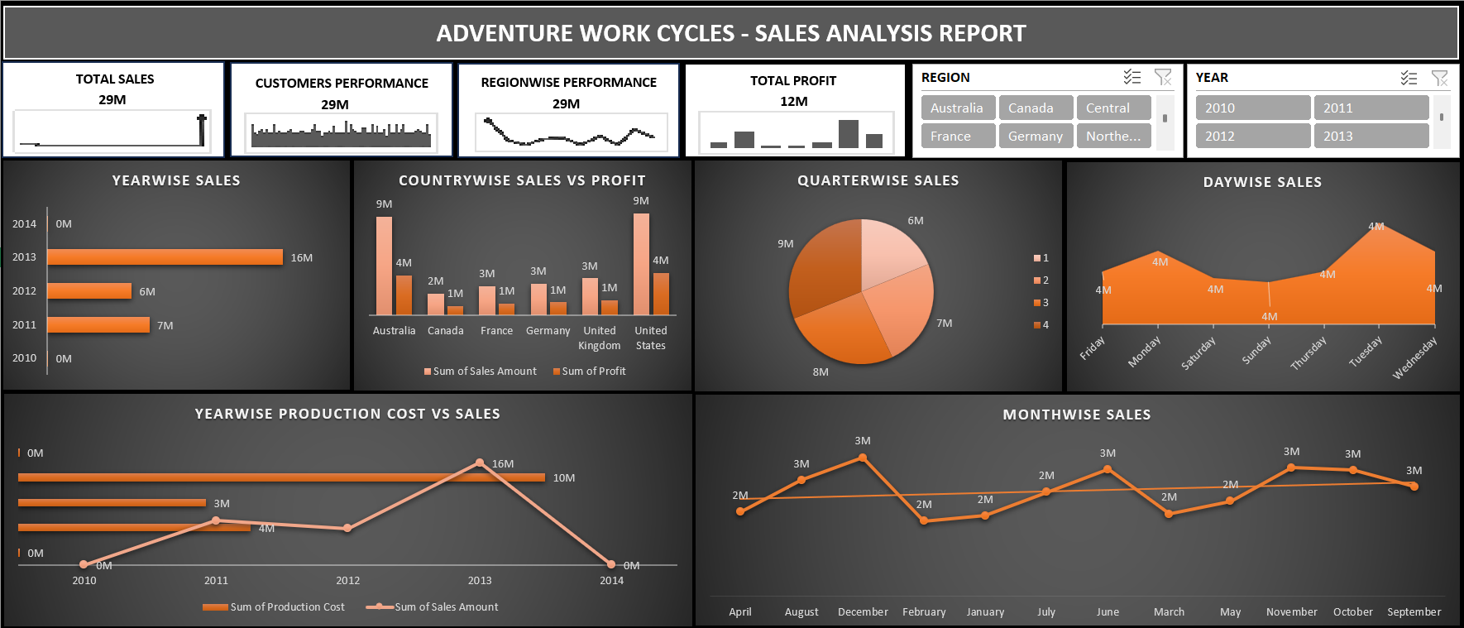
EXCEL DASHBOARD
VISUALS INCLUDED:
Year, Quarter, Month, Day wise Sales
Year wise Production Cost vs Sales
Country wise Sales vs Profit
ANNOTATIONS:
Highlighted trends, peak periods, and regional performance.

Slide 13
EXCEL DASHBOARD
VISUALS INCLUDED:
Year, Quarter, Month, Day wise Sales
Year wise Production Cost vs Sales
Country wise Sales vs Profit
ANNOTATIONS:
Highlighted trends, peak periods, and regional performance.

Slide 14
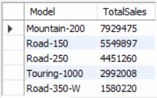
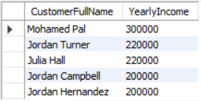
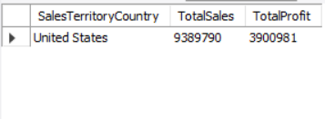
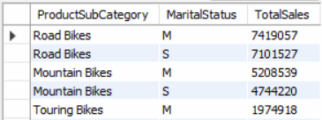
SQL QUERIES OUTPUT
TOP 5 MODELWISE SALES
TOP 5 CUSTOMERS BY SALES
SALES AND PROFIT USING STORED PROCEDURE
SALES BY PRODUCT SUBCATEGORY AND MARITAL STATUS

Slide 15
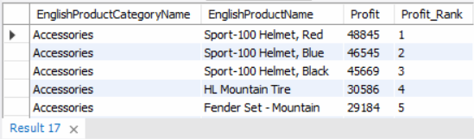
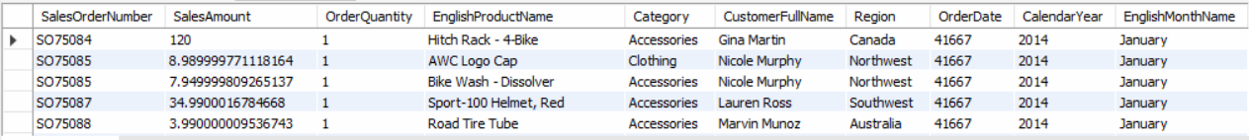
SQL QUERIES OUTPUT
RANK BASED ON PROFIT USING DENSE RANK ()
OUTPUT BY VIEW

Slide 16
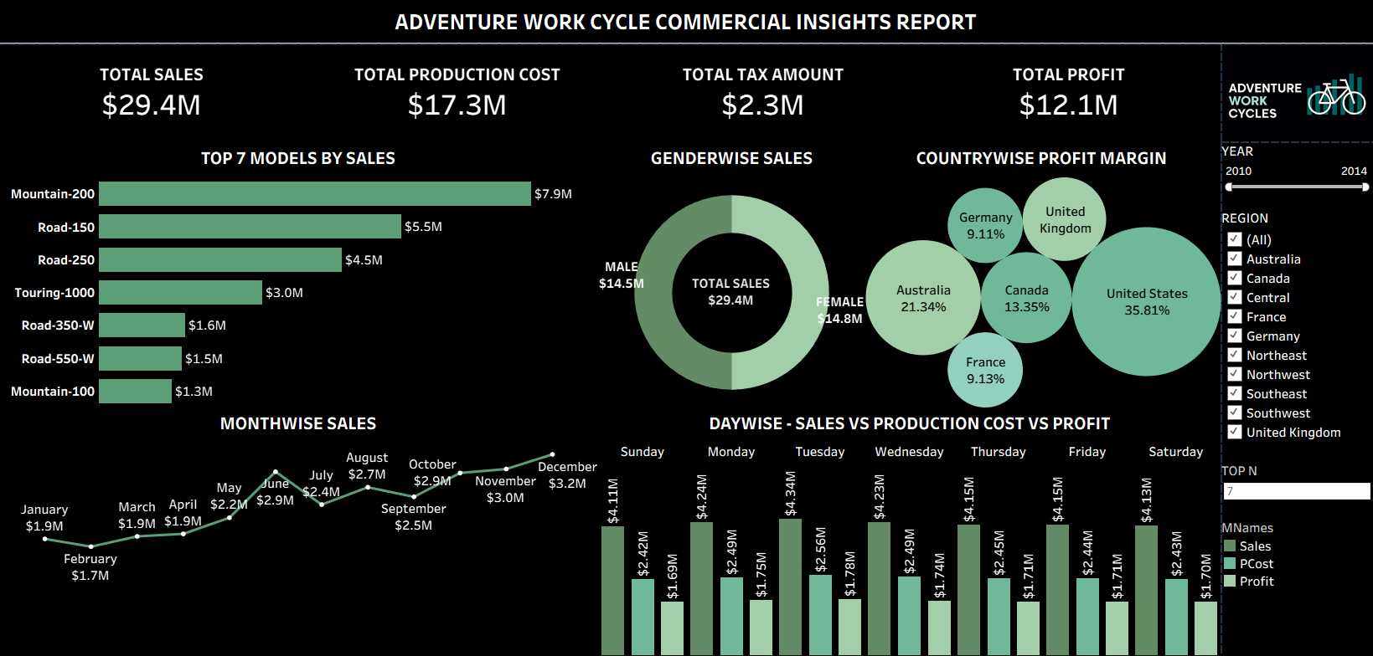
TABLEAU DASHBOARD
VISUALS INCLUDED:
Top N Models by Sales (Bar)
Day wise Sales vs Production Cost vs Profit (Columns)
Country wise Profit Margin (Bubble)
Month wise and Gender wise Sales (Donut)
FEATURES:
Interactive filters:
Parameter for Top N Models
Year and Region as Slicers

Slide 17
TABLEAU DASHBOARD
VISUALS INCLUDED:
Top N Models by Sales (Bar)
Day wise Sales vs Production Cost vs Profit (Columns)
Country wise Profit Margin (Bubble)
Month wise and Gender wise Sales (Donut)
FEATURES:
Interactive filters:
Parameter for Top N Models
Year and Region as Slicers

Slide 18
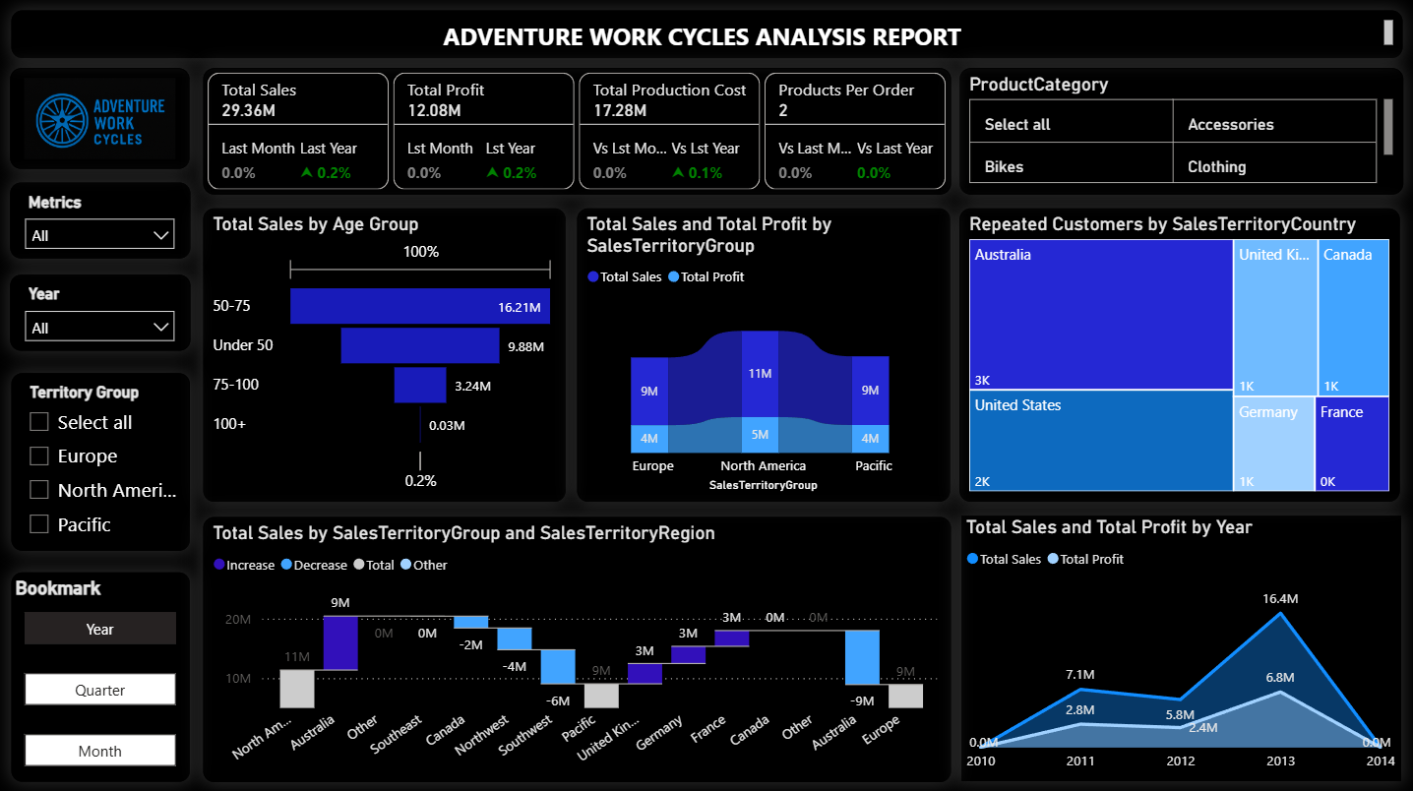
POWER BI DASHBOARD
VISUALS INCLUDED:
Age Group wise Sales and Profit (Funnel)
Territory Groupwise Sales and Profit (Ribbon)
Repeated Customers by Country (Tree Map)
Region and Territory Groupwise Sales and Profit (Waterfall)
Year, Quarter, Month wise Sales and Profit (Area)
FEATURES:
Slicers and Bookmarks for dynamic filtering
Hierarchy for Ribbon Chart
Conditional formatting and annotated visuals using Drill through

Slide 19
POWER BI DASHBOARD
VISUALS INCLUDED:
Age Group wise Sales and Profit (Funnel)
Territory Groupwise Sales and Profit (Ribbon)
Repeated Customers by Country (Tree Map)
Region and Territory Groupwise Sales and Profit (Waterfall)
Year, Quarter, Month wise Sales and Profit (Area)
FEATURES:
Slicers and Bookmarks for dynamic filtering
Hierarchy for Ribbon Chart
Conditional formatting and annotated visuals using Drill through

Slide 20
SUMMARY
OVERVIEW
The Adventure Work Cycles project integrated Excel, SQL, Tableau, and Power BI to deliver comprehensive commercial and sales insights. By combining multiple BI tools, the team analysed product performance, customer segmentation, and regional profitability to support strategic decision-making.
KEY LEARNINGS
DATA INTEGRATION MATTERS: Using SQL for structured queries and combining outputs with visualization tools ensured accuracy and consistency across dashboards.
VISUALIZATION ENHANCES STORYTELLING: Tableau and Power BI allowed interactive exploration of KPIs, making insights more accessible and actionable for stakeholders.
CUSTOMER SEGMENTATION DRIVES STRATEGY: Gender, age group, and territory-based analysis revealed patterns that can guide targeted marketing and product positioning.
REGIONAL PROFITABILITY INSIGHTS: Identifying high-margin regions (e.g., United States) highlighted opportunities for scaling and resource allocation.
TEMPORAL TRENDS ARE CRITICAL: Recognizing peak months (December) and high-performing days (Tuesday) emphasized the importance of time-based sales strategies.

Slide 21
SUMMARY
OVERVIEW
The Adventure Work Cycles project integrated Excel, SQL, Tableau, and Power BI to deliver comprehensive commercial and sales insights. By combining multiple BI tools, the team analyzed product performance, customer segmentation, and regional profitability to support strategic decision-making.
KEY LEARNINGS
DATA INTEGRATION MATTERS: Using SQL for structured queries and combining outputs with visualization tools ensured accuracy and consistency across dashboards.
VISUALIZATION ENHANCES STORYTELLING: Tableau and Power BI allowed interactive exploration of KPIs, making insights more accessible and actionable for stakeholders.
CUSTOMER SEGMENTATION DRIVES STRATEGY: Gender, age group, and territory-based analysis revealed patterns that can guide targeted marketing and product positioning.
REGIONAL PROFITABILITY INSIGHTS: Identifying high-margin regions (e.g., United States) highlighted opportunities for scaling and resource allocation.
TEMPORAL TRENDS ARE CRITICAL: Recognizing peak months (December) and high-performing days (Tuesday) emphasized the importance of time-based sales strategies.

Slide 22
SUMMARY
OVERVIEW
The Adventure Work Cycles project integrated Excel, SQL, Tableau, and Power BI to deliver comprehensive commercial and sales insights. By combining multiple BI tools, the team analysed product performance, customer segmentation, and regional profitability to support strategic decision-making.
KEY LEARNINGS
DATA INTEGRATION MATTERS: Using SQL for structured queries and combining outputs with visualization tools ensured accuracy and consistency across dashboards.
VISUALIZATION ENHANCES STORYTELLING: Tableau and Power BI allowed interactive exploration of KPIs, making insights more accessible and actionable for stakeholders.
CUSTOMER SEGMENTATION DRIVES STRATEGY: Gender, age group, and territory-based analysis revealed patterns that can guide targeted marketing and product positioning.
REGIONAL PROFITABILITY INSIGHTS: Identifying high-margin regions (e.g., United States) highlighted opportunities for scaling and resource allocation.
TEMPORAL TRENDS ARE CRITICAL: Recognizing peak months (December) and high-performing days (Tuesday) emphasized the importance of time-based sales strategies.

Slide 23
SUMMARY
OVERVIEW
The Adventure Work Cycles project integrated Excel, SQL, Tableau, and Power BI to deliver comprehensive commercial and sales insights. By combining multiple BI tools, the team analyzed product performance, customer segmentation, and regional profitability to support strategic decision-making.
KEY LEARNINGS
DATA INTEGRATION MATTERS: Using SQL for structured queries and combining outputs with visualization tools ensured accuracy and consistency across dashboards.
VISUALIZATION ENHANCES STORYTELLING: Tableau and Power BI allowed interactive exploration of KPIs, making insights more accessible and actionable for stakeholders.
CUSTOMER SEGMENTATION DRIVES STRATEGY: Gender, age group, and territory-based analysis revealed patterns that can guide targeted marketing and product positioning.
REGIONAL PROFITABILITY INSIGHTS: Identifying high-margin regions (e.g., United States) highlighted opportunities for scaling and resource allocation.
TEMPORAL TRENDS ARE CRITICAL: Recognizing peak months (December) and high-performing days (Tuesday) emphasized the importance of time-based sales strategies.

Slide 24
SUMMARY
OVERVIEW
The Adventure Work Cycles project integrated Excel, SQL, Tableau, and Power BI to deliver comprehensive commercial and sales insights. By combining multiple BI tools, the team analyzed product performance, customer segmentation, and regional profitability to support strategic decision-making.
KEY LEARNINGS
DATA INTEGRATION MATTERS: Using SQL for structured queries and combining outputs with visualization tools ensured accuracy and consistency across dashboards.
VISUALIZATION ENHANCES STORYTELLING: Tableau and Power BI allowed interactive exploration of KPIs, making insights more accessible and actionable for stakeholders.
CUSTOMER SEGMENTATION DRIVES STRATEGY: Gender, age group, and territory-based analysis revealed patterns that can guide targeted marketing and product positioning.
REGIONAL PROFITABILITY INSIGHTS: Identifying high-margin regions (e.g., United States) highlighted opportunities for scaling and resource allocation.
TEMPORAL TRENDS ARE CRITICAL: Recognizing peak months (December) and high-performing days (Tuesday) emphasized the importance of time-based sales strategies.

Slide 25
SUMMARY
OVERVIEW
The Adventure Work Cycles project integrated Excel, SQL, Tableau, and Power BI to deliver comprehensive commercial and sales insights. By combining multiple BI tools, the team analyzed product performance, customer segmentation, and regional profitability to support strategic decision-making.
KEY LEARNINGS
DATA INTEGRATION MATTERS: Using SQL for structured queries and combining outputs with visualization tools ensured accuracy and consistency across dashboards.
VISUALIZATION ENHANCES STORYTELLING: Tableau and Power BI allowed interactive exploration of KPIs, making insights more accessible and actionable for stakeholders.
CUSTOMER SEGMENTATION DRIVES STRATEGY: Gender, age group, and territory-based analysis revealed patterns that can guide targeted marketing and product positioning.
REGIONAL PROFITABILITY INSIGHTS: Identifying high-margin regions (e.g., United States) highlighted opportunities for scaling and resource allocation.
TEMPORAL TRENDS ARE CRITICAL: Recognizing peak months (December) and high-performing days (Tuesday) emphasized the importance of time-based sales strategies.

Slide 26
SUMMARY
OVERVIEW
The Adventure Work Cycles project integrated Excel, SQL, Tableau, and Power BI to deliver comprehensive commercial and sales insights. By combining multiple BI tools, the team analyzed product performance, customer segmentation, and regional profitability to support strategic decision-making.
KEY LEARNINGS
DATA INTEGRATION MATTERS: Using SQL for structured queries and combining outputs with visualization tools ensured accuracy and consistency across dashboards.
VISUALIZATION ENHANCES STORYTELLING: Tableau and Power BI allowed interactive exploration of KPIs, making insights more accessible and actionable for stakeholders.
CUSTOMER SEGMENTATION DRIVES STRATEGY: Gender, age group, and territory-based analysis revealed patterns that can guide targeted marketing and product positioning.
REGIONAL PROFITABILITY INSIGHTS: Identifying high-margin regions (e.g., United States) highlighted opportunities for scaling and resource allocation.
TEMPORAL TRENDS ARE CRITICAL: Recognizing peak months (December) and high-performing days (Tuesday) emphasized the importance of time-based sales strategies.

Slide 27
SUMMARY
OVERVIEW
The Adventure Work Cycles project integrated Excel, SQL, Tableau, and Power BI to deliver comprehensive commercial and sales insights. By combining multiple BI tools, the team analyzed product performance, customer segmentation, and regional profitability to support strategic decision-making.
KEY LEARNINGS
DATA INTEGRATION MATTERS: Using SQL for structured queries and combining outputs with visualization tools ensured accuracy and consistency across dashboards.
VISUALIZATION ENHANCES STORYTELLING: Tableau and Power BI allowed interactive exploration of KPIs, making insights more accessible and actionable for stakeholders.
CUSTOMER SEGMENTATION DRIVES STRATEGY: Gender, age group, and territory-based analysis revealed patterns that can guide targeted marketing and product positioning.
REGIONAL PROFITABILITY INSIGHTS: Identifying high-margin regions (e.g., United States) highlighted opportunities for scaling and resource allocation.
TEMPORAL TRENDS ARE CRITICAL: Recognizing peak months (December) and high-performing days (Tuesday) emphasized the importance of time-based sales strategies.

Slide 28
CONCLUSION
This project demonstrated how integrated BI ecosystems can transform raw data into actionable insights. By leveraging multiple tools, the team not only uncovered sales and profitability drivers but also built recruiter-ready dashboards that showcase technical depth, storytelling ability, and business impact.

Slide 29
CONCLUSION
This project demonstrated how integrated BI ecosystems can transform raw data into actionable insights. By leveraging multiple tools, the team not only uncovered sales and profitability drivers but also built recruiter-ready dashboards that showcase technical depth, storytelling ability, and business impact.

Slide 30
THANK YOU

